Slide 1
Introductory Interaction Design
Summer 2020
Hiroki Nishino, Ph.D.
Assistant Professor, Shanghai Tech University

Slide 2
Contact: Lecturer
Hiroki Nishino, Ph.D.
hiroki.nishino@gmail.com
Must be by email! (no WeChat!)
NOTE: Don’t call me Prof. Nishino. Just Hiroki or Dr. Nishino is okay. Some students prefer to call me ‘Hiroki sensei’ or simple ‘sensei’.
Also, don’t call any university professor ‘Teacher’ regardless of his/her rank (lecturer/assistant prof./associate prof./full prof.)! University Professors are not ‘teachers’; Teacher is not an English translation of ‘professor.’

Slide 3
Contact: Teaching Assistant
章嘉乐 (Zhāng Jiā Lè)
email : zhangjl1@shanghaitech.edu.cn
WeChat: MakerHCI

Slide 4
Course Outline
Students learn basic knowledge and skills for physical computing.
Digital Input/Output
Analog Input/Output
Servo Motors and DC Motors, etc.
Two Writing Assignments
Explain this artwork: TV Helmet.
Explain the useless invention concept by Marina Fujiwara in the context of Emotional Design and other previous works.
Midterm Project : Interactive Busy Board
Final Project : Useless Inventions

Slide 5
Grading
Two Writing Assignments
10% (first) + 20% (second) of the entire grade.
Midterm Project
30% of the entire grade.
Proposal/Write-up (10%)
Prototype (20%)
Final Project
40% of the entire grade.
Proposal/Write-up (20%)
Prototype (20%)

Slide 6
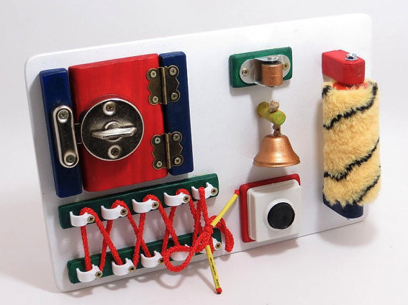
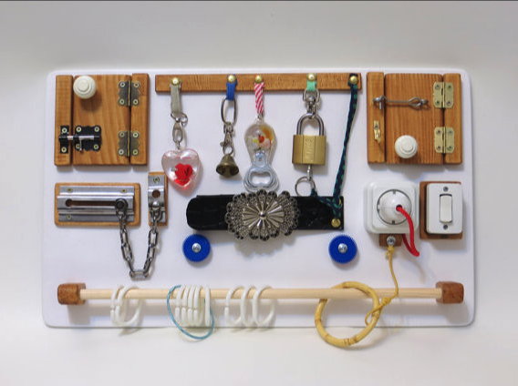
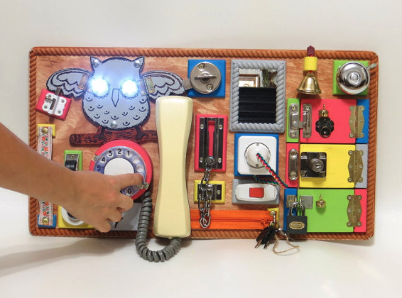
Midterm Project: Interactive Busy Board
Create a busy board. Make it interactive with the Arduino.
Imageｓ: https://www.flickr.com/photos/linearahandmade (Attribution 2.0 Generic (CC BY 2.0)

Slide 7


Final Project: Useless Inventions (無駄作り; 無用發明）
No More Greasy Fingers... I want to read a comic while eating chips but I don't want dirty my fingers.So...
(c) 2019, Marina Fujiwara, All Right Reserved. (courtesy of the artist)
Useless Inventions
A design concept proposed by Japanese Artist: Marina Fujiwara, who creates various machines that are barely useful.
Create a useless machine.
Use sensors and actuators.
Make it useless but funny.
Refer to ‘an everyday life issue’
The guardian of my cake (c) 2019, Marina Fujiwara, All Right Reserved.
(courtesy of the artist)
Video and Image from https://www.instagram.com/mudazukuri/ CC BY-NC-SA

Slide 8
無用發明: Marina Fujiwara

Slide 9
Writing Assignment #1
Deadline: August 7th 23:59.

Slide 10
Midterm Project Proposal #1 (part of your midterm grade)
Write a brief note what is the design concept of your busy board.
(In other words, explain what and why).
What do you focus on in your design? colors, tactile texture, sound, materials?
What do you use? Why you use them?
The purchase list must be included (the purchase must be completed).
Don’t forget to organize your writing with sections (and subsections if necessary).
Max 300 words (expect the purchase list).
Deadline: August 10th 23:59.

Slide 11
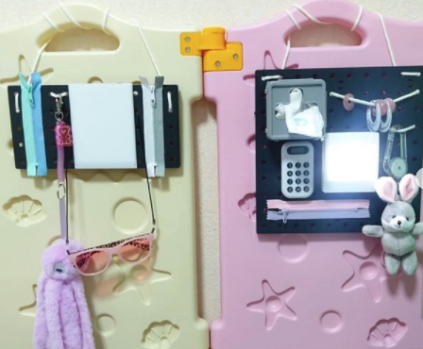
Midterm Project Proposal #1 (part of your midterm grade)
You can go to DAISO or名創優品 to cheap materials.
Yet, it is highly recommended to search for materials that fit your concept as possible.
Don’t randomly create one without any concept!!

Slide 12
What do we use for this project?
Arduino
a simple card-size single board computer.
widely used to prototype interactive artworks and products.
equipped with digital/analog input/output.
can control various sensors and actuators.
can be easily connected to your laptop/desktop computer.
can be programmed in C++.
Open source hardware/software.
Image: https://commons.wikimedia.org/wiki/File:Arduino_Uno_-_R3.jpg (Creative Commons Attribution 2.0 Generic license).

Slide 13
Good News
We do not use the C++ programming language in this course.
We use the alpha version of the Ardestan visual programming language.
You don’t write any textual code.
You can visually program everything in this course.

Slide 14
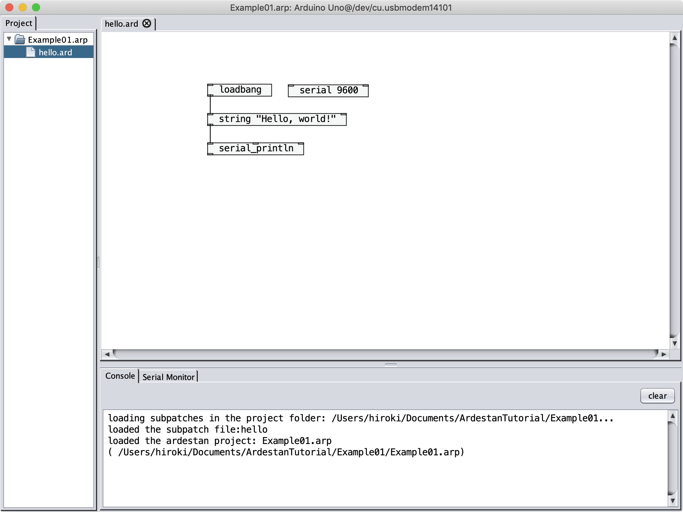
The Ardestan Visual Programming language
The language is designed for art and design students without prior programming experience.
You can program everything visually just by creating ‘object boxes’ and connecting them.
Multi-platform support (macOS/linux/Windows).
This language is still under development (by me!)

Slide 15
Download and Installation
Go to the course website and follow the instruction.
Course Slides:
https://github.com/hiroki-nishino/IntroductoryInteractionDesign
Download:
https://github.com/hiroki-nishino/IntroductoryInteractionDesign/releases

Slide 16
Session 1: Introduction to Ardestan and Digital Input/Output

Slide 17
What We Learn Today
Introduction to the Ardestan Visual Programming Language
object boxes and connections
inlets and outlets
arguments
messages
loadbang object
symbol object
dout object
depth-first message-passing
hot and cold inlets
Timing objects
delay object
metro object
Digital Output
Ohm’s law
resistor
breadboard
LED
vibration motor
mini piezo speaker
tone object
Flow Control
trigger object
gate object
select object
spigot object
Operators
arithmetic operator object
relational operator object
logical operator objects
Algorithm
counter implementation
Serial Monitor
serial object
serial_println object
Digital Input
din_change object
toggle object
pull-up resistor
chatter (contact bounce)

Slide 18
Session 1.1: Introduction to the Ardestan Visual Programming Language

Slide 19

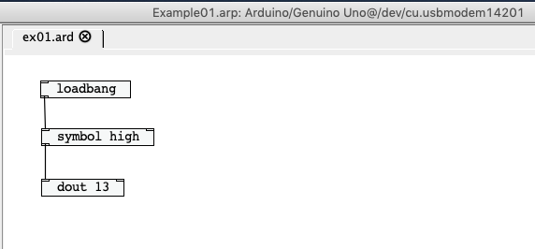
How to Program an Arduino in Ardestan
compile
upload
A visual program in Ardestan.
Machine code for your Arduino.
Your Arduino runs the program!
Image of Arduino: https://commons.wikimedia.org/wiki/File:Arduino_Uno_-_R3.jpg (Creative Commons Attribution 2.0 Generic license).

Slide 20
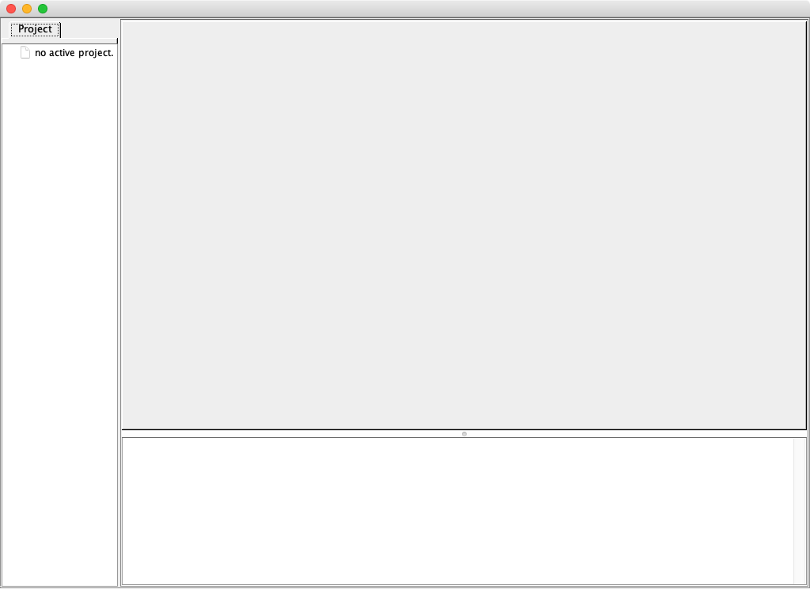
Ardestan IDE
First, you see such a window.

Slide 21
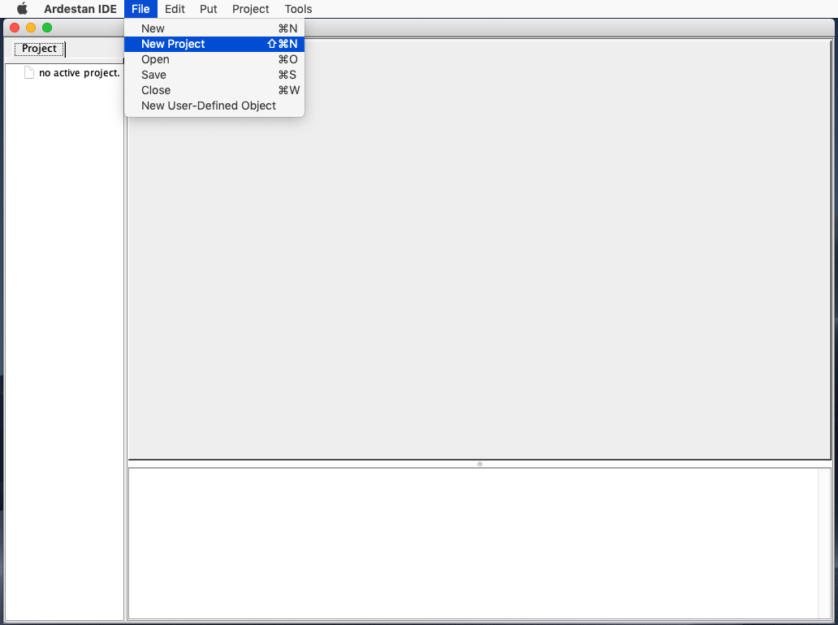
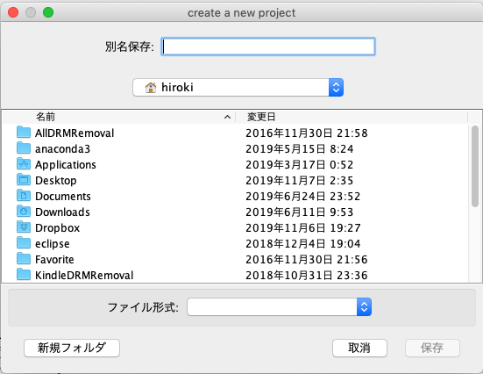
Create Your First Project
Create a new project.

Slide 22
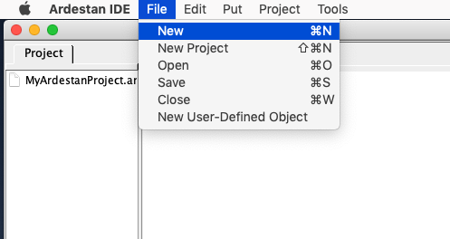
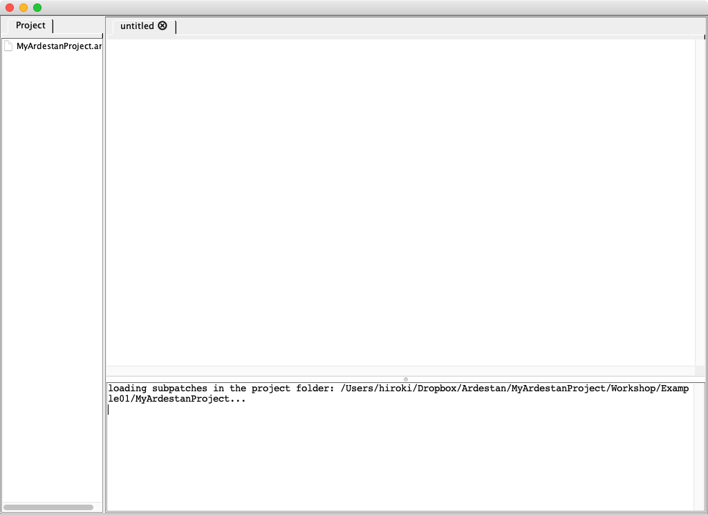
Create Your First Program File
Create a new file.

Slide 23
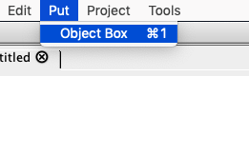
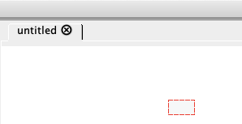
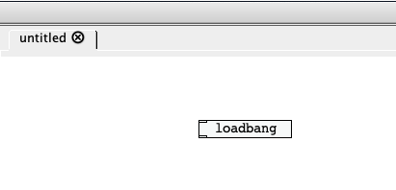
Object Box
Create an object box
Click it and type an object name.
This time we create a ‘loadbang’ object.

Slide 24
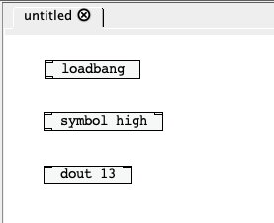
Object Box
Create three objects as on the left figure.

Slide 25
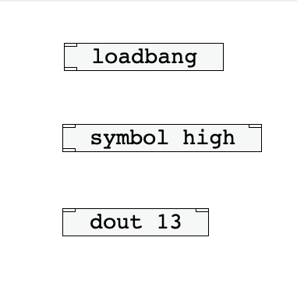
Inlet
The rectangles at the top of the object box are called ‘inlets.’

Slide 26
Outlet
The rectangles at the bottom of the object box are called ‘outlets.’

Slide 27
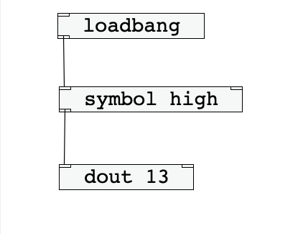
Example 01
Drag the mouse cursor from an outlet to an inlet, then a connection is built between the outlet and inlet.
To Delete a connection, put the mouse cursor on the connection. Then, the color of the connection will be changed to blue. If you type backspace (win/linux) or delete (mac), the connection will be removed.

Slide 28
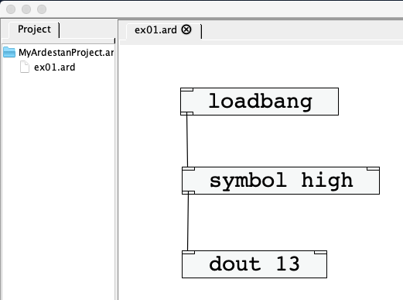
Save Your First Program
Now, save your program as ex01.ard
Don’t forget to give the file ‘.ard’ extention!
In Ardestan, we often call a visual program ‘a patch’.

Slide 29
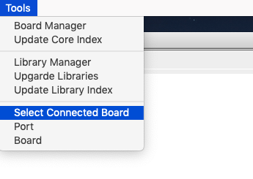
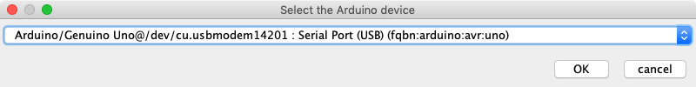
Select Connected Board
Now, connect your Arduino to your laptop.
Then, select the Arduino from the list.

Slide 30
Select Connected Board
Now, the window title should show the Arduino and the port name like below.

Slide 31
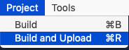
Build and Upload
Select the ‘build and upload’ menu item.
Your program should be compiled and uploaded to the Arduino.
If there is no problem, the LED on your Arduino should light up.

Slide 32
Try Example 01
Now!

Slide 33
How Example 01 works
Now, let’s understand what is happening with this program.
Yet, before we learn how this program behaves, let’s learn the function of each object.

Slide 34
Ardestan Objects
What we type first in an object box is the type of the object.
Hence, the left program contains thee different objects: one loadbang object, one symbol object, and one dout object.

Slide 35
Argument
An object box often contains one or more arguments after the name of the object.
Arguments are normally used to initialize the object.
In the left program, the symbol object is given one argument:high and the dout object is given one argument:13.

Slide 36
Loadbang Object
The loadbang object sends out a symbol:’bang’ when your Arduino starts up or resets.
A symbol is a type of a value that is passed between Ardestan objects.
We learn other types in Ardestan a little later

Slide 37
Symbol Object
The symbol object stores a symbol value within. When it received a ‘bang’ message, it sends out the stored symbol value from its outlet.
In the left example, we initially stores a symbol: ’high’ in the symbol object.
Some objects requires (or opitinally allows) one ore more values to be given after the object name. Such values is called ‘arguments’ in Ardestan and normally used to initialize the Ardestan object.

Slide 38
Dout Object
The dout object set the digital output at the given pin number high or low, depending on the value it received at the left inlet.
If the incoming value is a symbol:’high’ or an integer value:1, it sets the digital output pin to high.
If the incoming value is a symbol:’low’ or an integer value:0, it sets the digital output pin to low.

Slide 39
Dout Object
Digital Output in Arduino:
high => the output is 5v.
low => the output is 0v.

Slide 40
Message-passing
The loadbang object will send out a symbol:‘bang’ when the program starts on your Arduino.
The message will be received by all the objects connected to the outlet of the ‘loadbang’ object.
bang

Slide 41
Message-passing
When the ‘symbol’ object receives the symbol:‘bang’ at its left inlet, it immediately sends out the symbol :’high’ (which is stored inside).
symbol ‘high’

Slide 42
Message-passing
When the ‘dout’ object receives the symbol:’high’ at its left inlet, it set the digital output at the given number (in this case, it is 13) high.
As the digital output 13 of the Arduino is connected to the on-board LED, it lights up.

Slide 43
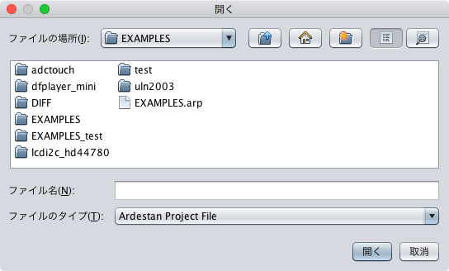
How to Open Your Project
To open your project later, select a‘.arp’ file(such as EXAMPLES.arp) from the open dialog. (Menu: Project -> Open Project).

Slide 44
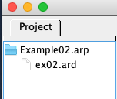
How to Open You File
To open your program, the click the a ‘.ard’ file at the Project tab.

Slide 45
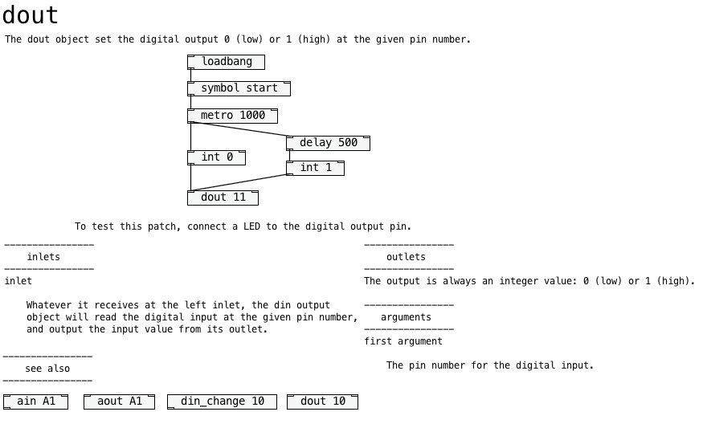
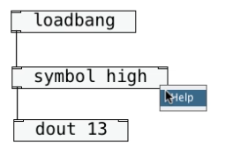
Help Patch
Use the right click on the object. Select the Help from the pop-up menu. The IDE will show the help file.

Slide 46
Message Types
There are four kinds of messages in Ardestan
Integer
32bit integer values such as 0, 1, -99, 100, etc.
Float
32bit floating point values such as 0.11, -.19234, 112.3 etc.
Symbol
consists of alphabets, digits, and underscore (’_’). Such values as high, low, etc.
Internally represents as a unique ID (of 32bit integer).
String
A sequence of characters.
Must be wrapped by double quotation marks (“Hello”, “good-bye”, “This is a string value.”, etc.).

Slide 47
Turning the on-board LED off
Just lighting up the on-board LED is not interesting.
Now, let’s turn it off after 2 seconds.

Slide 48
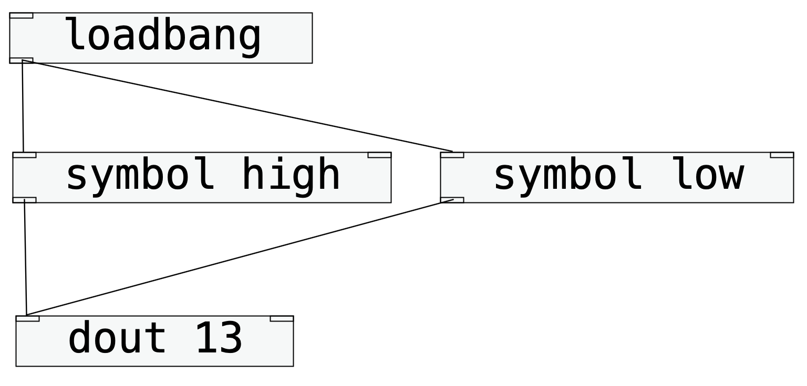
Ardestan: Example 02
To turn off the digital output, send the symbol message:low to the dout object.
Let’s run this program on your Arduino.
You may see the program just turns off the LED or just lights it up.

Slide 49
Depth-first Message-passing
The chain reaction of the message passing will be performed ‘depth first’

Slide 50
Ardestan: Example 02
In Ardestan, if there are two or more connections exist at the same outlet, the order of execution is ‘undefined’ (this could be different in the later version; yet at this point it is undefined).
We deals with how to control the order of message-passing a little later.

Slide 51
Depth-first Message-passing
Now, let’s assume that the connection to the left symbol object (symbol high) is processed first.
The left symbol object receives a symbol:bang.
bang

Slide 52
Depth-first Message-passing
Then, the left symbol object immediately reacts to the input message and sends out a symbol:high to the dout object.
The dout object turns on the digital output.
The dout object doesn’t send out any message to other object, so the chain reaction ends here.
high

Slide 53
Depth-first Message-passing
Now, we already finished the chain reactions from the left symbol object.
Then, the loadbang object sends out a symbol:bang to the right symbol object.
bang

Slide 54
Depth-first Message-passing
As the right symbol object received the input message (bang), it immediately reacts to the input and sends out the symbol:low to the dout object.
The dout object sets the digital output low and the chain reaction is finished again.
Since we don’t have any more event to process, the program does nothing from now on.
low

Slide 55
Depth-first Message-passing
Thus, messages in Ardestan are passed in the depth-first order.

Slide 56
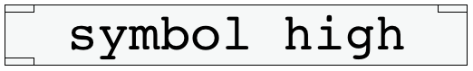
Hot and Cold Inlets
Many objects has two or more inlets.
Normally, objects immediately react to the incoming message only at the left most inlet.
The other inlets only update the internal data(there are some exception).
For instance, the symbol object only updated the stored symbol when it receives a symbol at its right inlet, but it doesn’t output any message, while it immediately reacts to the input message when it receives a symbol at the left inlet.

Slide 57
Hot and Cold inlets
Hot inlet
An inlet (normally the left most inlet) that immediately causes a chain reaction.
Cold inlet
An inlet (normally the other inlet(s)) that only changes the internal state/data of the object without causing any chain reaction.

Slide 58
What We Learned So Far
Introduction to the Ardestan Visual Programming Language
object boxes and connections
inlets and outlets
arguments
messages
loadbang object
symbol object
dout object
depth-first message-passing
hot and cold inlets
Timing objects
delay object
metro object
Digital Output
Ohm’s law
resistor
breadboard
LED
vibration motor
mini piezo speaker
tone object
Flow Control
trigger object
gate object
select object
spigot object
Operators
arithmetic operator object
relational operator object
logical operator objects
Algorithm
counter implementation
Serial Monitor
serial object
serial_println object
Digital Input
din_change object
toggle object
pull-up resistor
chatter (contact bounce)

Slide 59
Session 1.2: Timing Objects

Slide 60
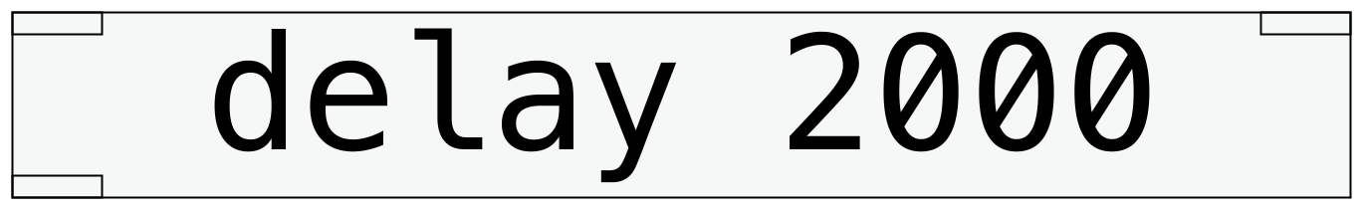
Delay Object
What we need to do is to turn the LED off after 2 seconds.
We can use the delay object.
When a delay object received a message at its left inlet, it sends out it from its outlet after the given duration (in msec).
In the above example, it delays 2000 msec (= 2.0 sec).

Slide 61
Exercise 01
Modify Example 02 with a delay object.
Let the LED light up for 2 seconds and then turn it off.

Slide 62
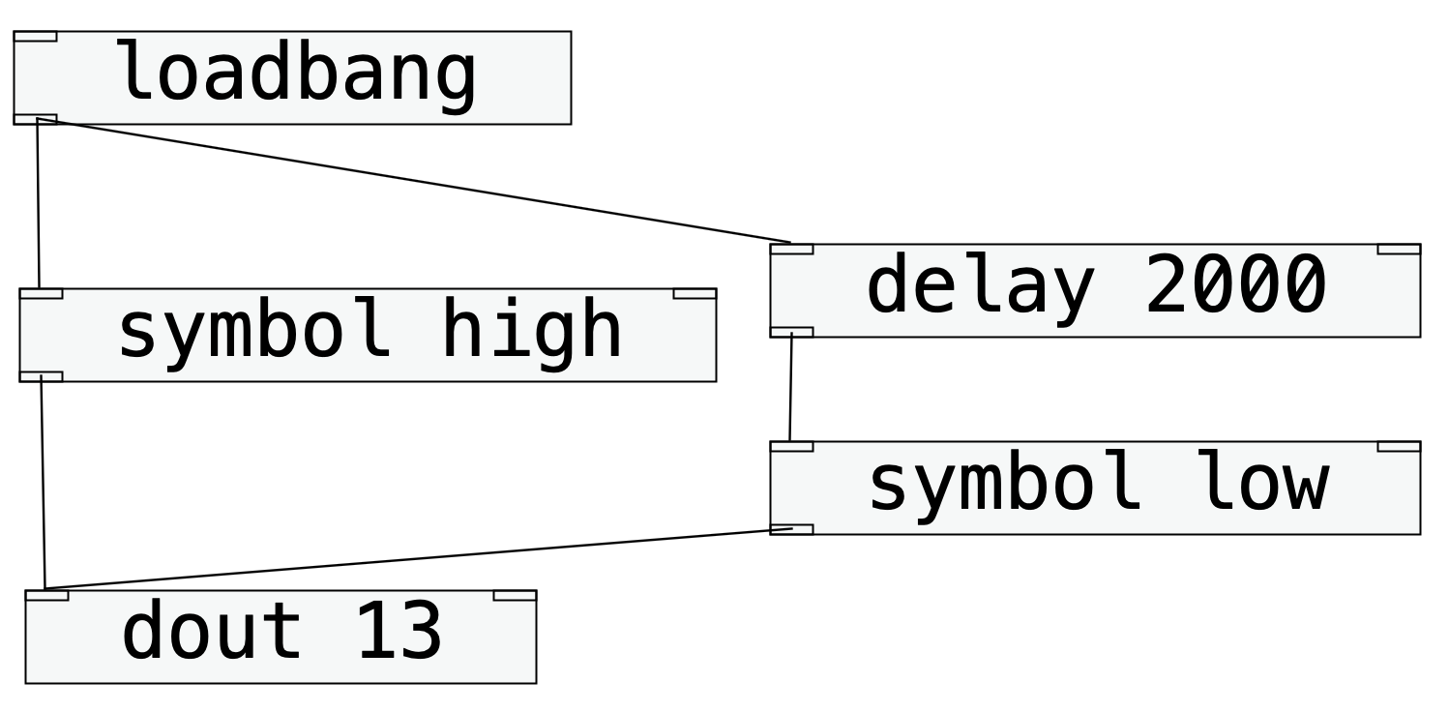
Ardestan: Example 03
This is one of the possible answers to Exercise 01.

Slide 63
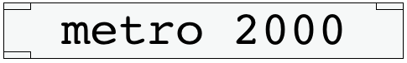
Metro Object
When a metro object received a symbol message:start at its left inlet, it repeatedly sends out a ‘bang’ message at the given period.
When it receives a symbol message:stop at its left inlet, it stops sending out a ‘bang’ message.
In the above example, the period is 2000 msec (= 2.0 sec).

Slide 64
Exercise 02
Modify the left example with a metro object and one more symbol object to blink LED at the period of two seconds (1000 msec on + 1000 msec off).

Slide 65
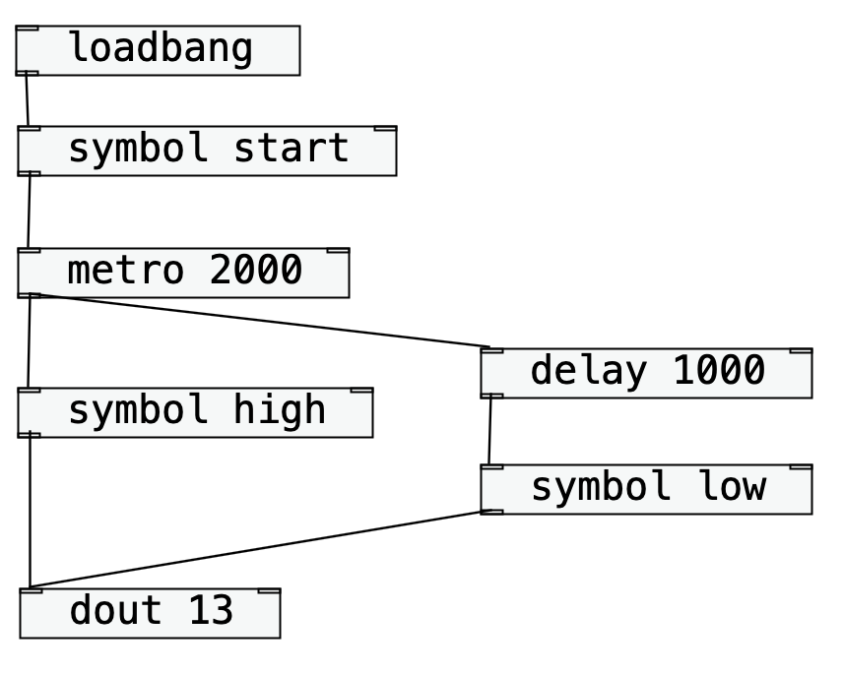
Ardestan: Example 04
Here is the one of the possible answers.

Slide 66
What We Learned So Far
Introduction to the Ardestan Visual Programming Language
object boxes and connections
inlets and outlets
arguments
messages
loadbang object
symbol object
dout object
depth-first message-passing
hot and cold inlets
Timing objects
delay object
metro object
Digital Output
Ohm’s law
resistor
breadboard
LED
vibration motor
mini piezo speaker
tone object
Flow Control
trigger object
gate object
select object
spigot object
Operators
arithmetic operator object
relational operator object
logical operator objects
Algorithm
counter implementation
Serial Monitor
serial object
serial_println object
Digital Input
din_change object
toggle object
pull-up resistor
chatter (contact bounce)

Slide 67
Session 1.3: Digital Output

Slide 68
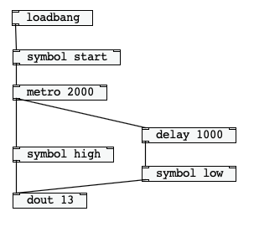
Blinking a LED
Now, let’s change the code in the left figure so that it can blink an external LED.
But before doing so…

Slide 69
OHM’s LAW
Do you remember what you learned in your Jr. high school?
electric voltage, electric current, electric resistance
electric current = the quantity of water coming out.
water
voltage = the power to push.
resistance = the size of the nozzle

Slide 70
OHM’s LAW
V = IR
electric current = the quantity of water coming out.
water
voltage = the power to push.
resistance = the size of the nozzle

Slide 71
OHM’s LAW
V = IR
Push Harder (a larger voltage) with the same nozzle (the same resistance). => More Water Coming out (more electric current)
electric current = the quantity of water coming out.
water
voltage = the power to push.
resistance = the size of the nozzle

Slide 72
OHM’s LAW
V = IR
The same power (the same voltage) and the larger nozzle (less resistance), => More Water Coming out (moreelectirc current)
electric current = the quantity of water coming out.
water
voltage = the power to push.
resistance = the size of the nozzle

Slide 73
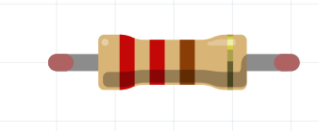
Resistor
Without any resistance, a short circuit (the direct connection between + and -) is created.
This can break both the Arduino and circuits.
We can use resistors to add some resistance to your circuit.
How to read the resistor color codes
The resistance value of a resistor is indicated by the color code.
For example, the resistor on the right has the code of red-red-brown-gold, which means (20 + 2) * 10 ohm ± 5% =(220ohm resistor).
In your kit, you have orange-orange-brown-gold = 330 ohm ± 5% brown-black-red-gold = 1000 ohm ± 5% brown-black-orange-gold = 10k ohm ± 5%
black | 0 | 0 | * 1 ohm
brown | 10 | 1 | * 10 ohm
red | 20 | 2 | * 100 ohm
orange | 30 | 3 | * 1k ohm
yellow | 40 | 4 | * 10k ohm
green | 50 | 5 | * 100k ohm
blue | 60 | 6 | * 1M ohm
purple | 70 | 7 | * 10M ohm
grey | 80 | 8
white | 90 | 9
gold | ± 5%
silver | ±10%

Slide 74
Resistor
You can simply use a multimeter to measure the resistance.
black | 0 | 0 | * 1 ohm
brown | 10 | 1 | * 10 ohm
red | 20 | 2 | * 100 ohm
orange | 30 | 3 | * 1k ohm
yellow | 40 | 4 | * 10k ohm
green | 50 | 5 | * 100k ohm
blue | 60 | 6 | * 1M ohm
purple | 70 | 7 | * 10M ohm
grey | 80 | 8
white | 90 | 9
gold | ± 5%
silver | ±10%
Image (left): https://commons.wikimedia.org/wiki/File:Measure_the_resistance.jpg ( Creative Commons Attribution-Share Alike 3.0 Unported license.)

Slide 75
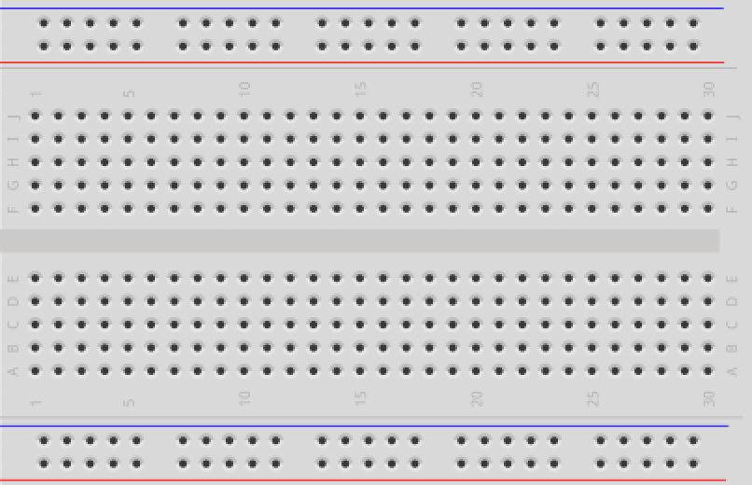
Breadboard
‘Breadboard’ is a useful tool for prototyping

Slide 76
Breadboard
These holes are connected horizontally inside.

Slide 77
Breadboard
These holes are connected vertically inside.

Slide 78
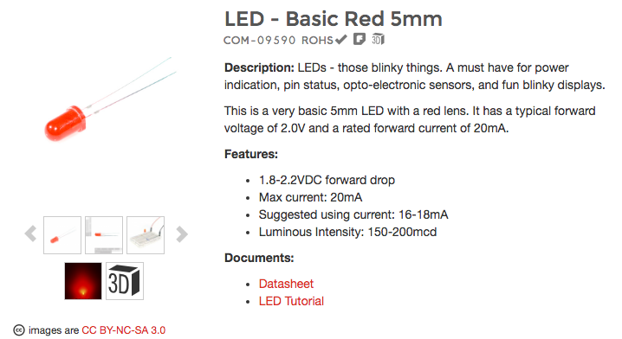
LED
LED
Light Emitting Diode
The Longer leg
Anode
Should be connected to +
The shorter leg
Cathode
Should be connected to –
Otherwise, electricity doesn’t go through.
This image is from https://www.sparkfun.com/products/9590, accessed on Oct- 09-2016.

Slide 79
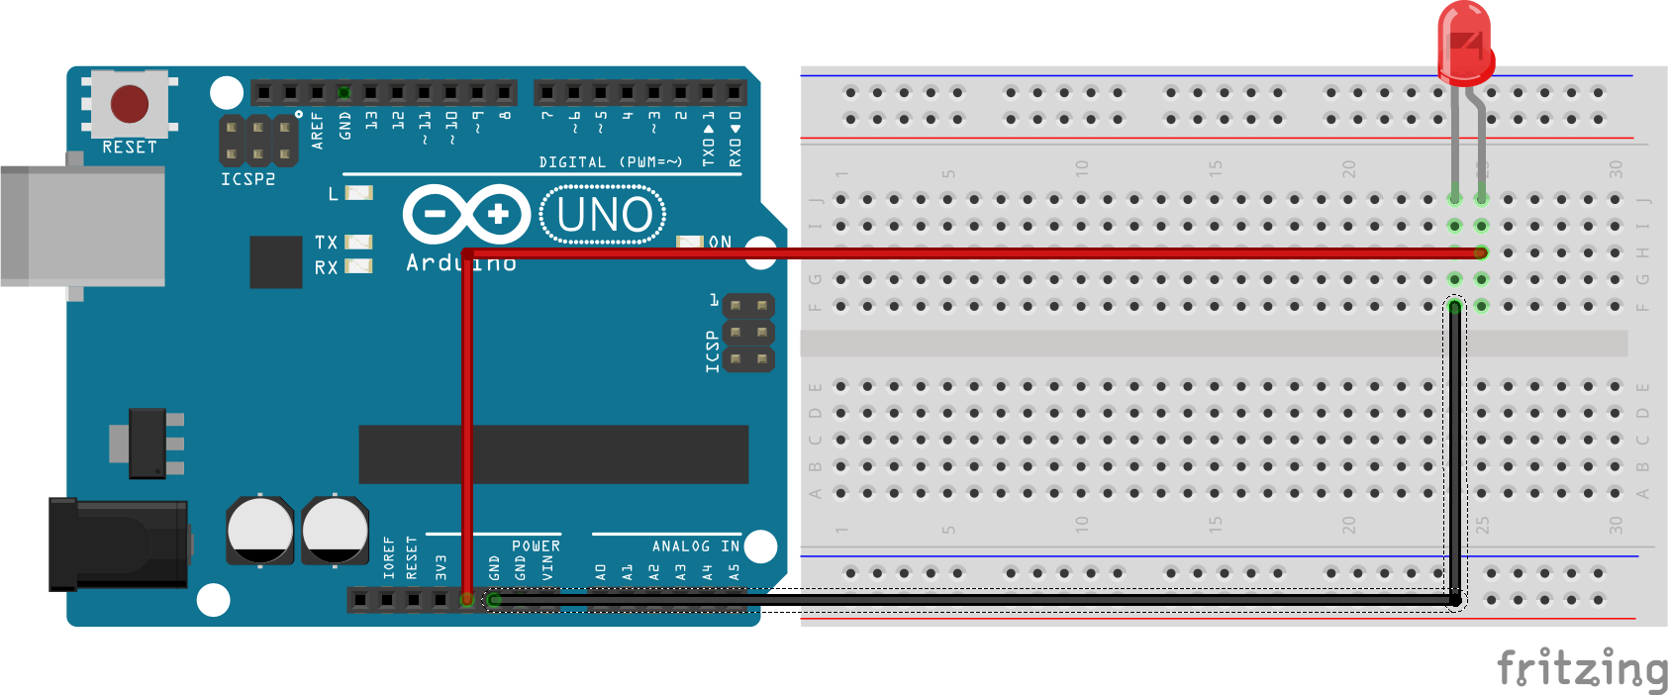
LED
Let’s burn your LED out.
Connect your LED directly to the 5V output and GND of your Arduino.
Don’t try this if you don’t have any extra LED!
The LED may burn out and it can smell bad!

Slide 80
we need to limit the electric current less than this.
Image: https://www.sparkfun.com/products/9590 CC BY-NC-SA 3.0

Slide 81
V
When the LED emits the light, the voltage goes down
Image: https://www.sparkfun.com/products/9590 CC BY-NC-SA 3.0

Slide 82
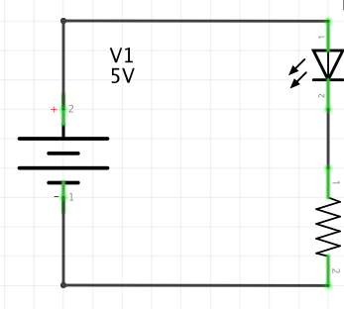
LED
How can we control the current flows in to the LED?
Use a resistor.
Let’s see the example on the right.
VF (forward voltage drop) -> 2v
Then, the rest part of the circuit will be 5-2 = 3 v.
VF=2V
3v (= 5v-2v)

Slide 83
LED
Let’s say we want 20mA (0.02A) for this circuit to use this LED.
V=IR 3 = 0.02 * R
R = 3/0.02 = 150
so use a 150Ω resistor. you don’t have a 150Ω resistor in the kit.
just use a 200Ω resistor.
VF=2V
3v (= 5v-2v)

Slide 84
LED
If we use a 200Ω resistor, how much current will flow in this circuit?
VF=2V
3v (= 5v-2v)

Slide 85
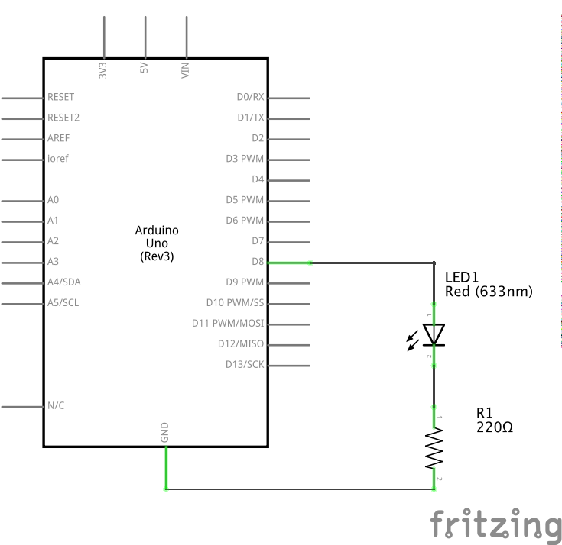
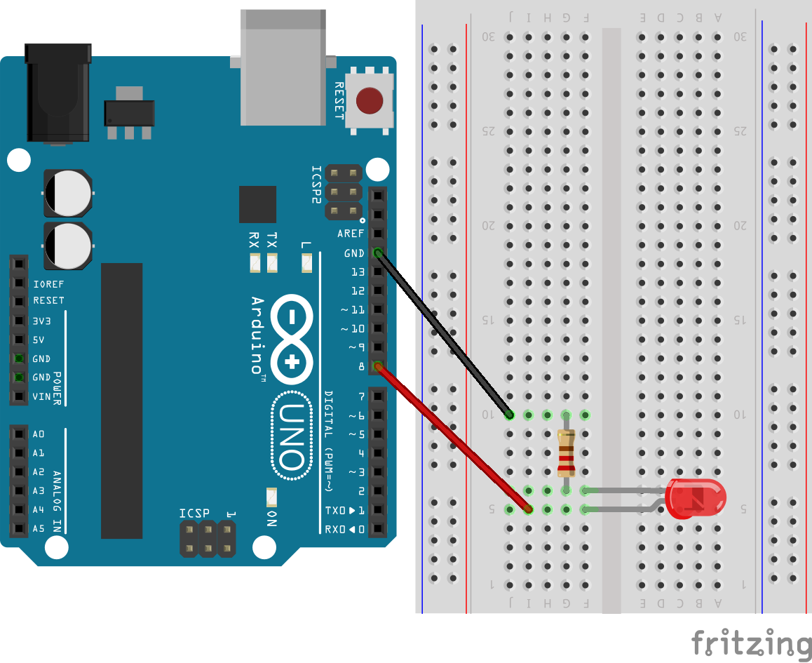
Digital output
First, let’s connect the LED to the pin 08

Slide 86
Exercise 03
Modify the left program to blink a LED connected at the digital output pin #8 (The left program is currently blinking the pin #13).
(This is easy; no need to give an example answer.)

Slide 87
Exercise 04
Design the circuit with two LEDs.
Modify the program left to blink two LEDs connected at the pin #8 (1 sec on/ 1sec off) and the pin #9 (1.5 sec on/ 1.5 sec off).

Slide 88
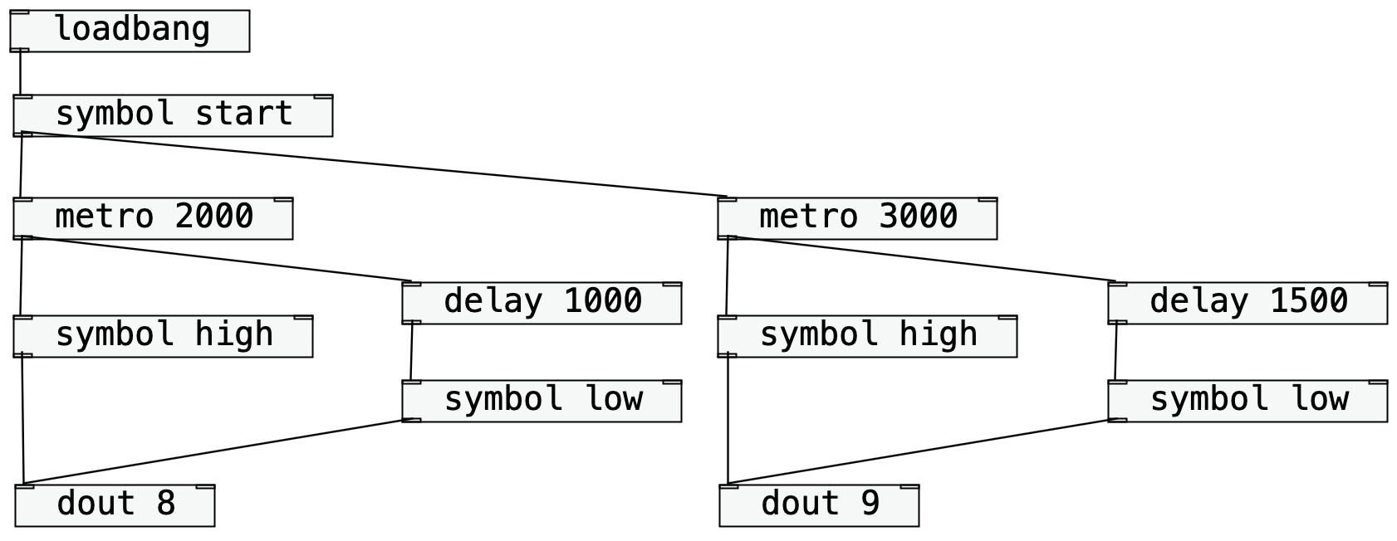
Ardestan: Example 05

Slide 89
Vibration Motor
You can also connect a small vibration motor to the digital output.
Image: https://www.sparkfun.com/products/8449 CC-BY 2.0

Slide 90
What We Learned So Far
Introduction to the Ardestan Visual Programming Language
object boxes and connections
inlets and outlets
arguments
messages
loadbang object
symbol object
dout object
depth-first message-passing
hot and cold inlets
Timing objects
delay object
metro object
Digital Output
Ohm’s law
resistor
breadboard
LED
vibration motor
mini piezo speaker
tone object
Flow Control
trigger object
gate object
select object
spigot object
Operators
arithmetic operator object
relational operator object
logical operator objects
Algorithm
counter implementation
Serial Monitor
serial object
serial_println object
Digital Input
din_change object
toggle object
pull-up resistor
chatter (contact bounce)

Slide 91
Mini Speaker
You can also play a simple melody with a mini piezo speaker using the digital output pin.

Slide 92
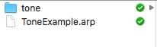
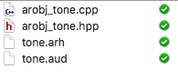
Mini Speaker
Download the file: ‘tone.zip’ and extract the directory ‘tone’ and put it in your directory (there should be four files in the tone directory.
Image: https://www.sparkfun.com/products/7950 CC-BY 2.0

Slide 93
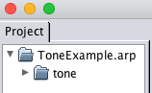
Mini Speaker
Download the file: ‘tone.zip’ and extract the directory ‘tone’ and put it in your directory (there should be four files in the tone directory.
This folder contains an ‘external object’ and then, it should shown up in the project explorer window of the IDE.
Image: https://www.sparkfun.com/products/7950 CC-BY 2.0

Slide 94
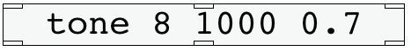
Tone Object
Now you can use the tone object.
The tone object can take three arguments
First argument (required)
The pin no. you connected the mini speaker (the other pin of the mini speaker should go to the GND).
The second argument (optional)
The duration of the note in msec.
The default duration is 1000msec.
You can dynamically change the duration by passing an integer value at the middle inlet.
The third argument (optional)
The ratio between the sound and the rest in the given duration.
If the ratio is set to 0.7 and the duration is 1000 msec, the sound will be played for 700 msec and the rest that follows the sound will be 300 msec.
This parameter can be also dynamically changed by passing a float value to the right inlet.

Slide 95
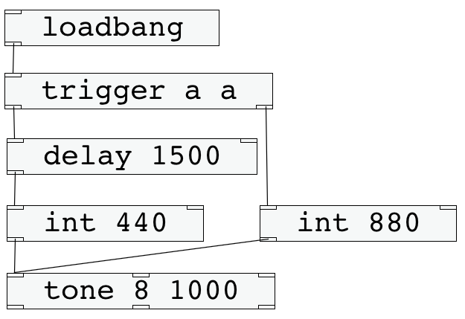
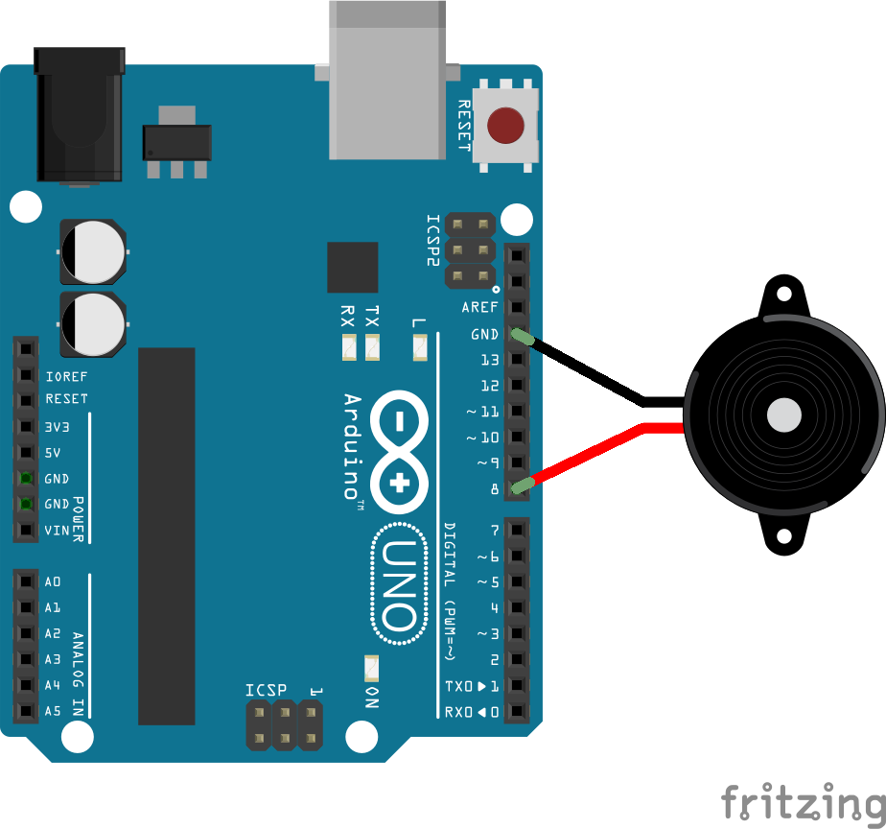
Ardestan: Example 06
Just try this simple example.
Connect a mini piezo speaker to the pin #8 and the GND.

Slide 96
Trigger Object
What does the trigger object do?

Slide 97
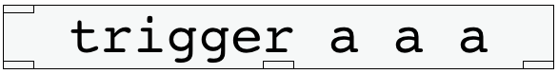
Trigger Object
The trigger object can clarify the order of execution.
When it receives a message at its inlet, it output the incoming message from its outlet in the right to left order.
It can also convert the message according to the given argument(s).
At this point, simply use ‘a’ for the argument(s). It simply pass the input message through to the outlets.
See help for the other arguments.
The trigger object can have the max 8 outlets. The number of the outlets is the same as the number of the given arguments.

Slide 98
Trigger Object
The trigger object can clarify the order of execution.
When it receives a message at its inlet, it output the incoming message from its outlet in the right to left order.
It can also convert the message according to the given argument(s).
At this point, simply use ‘a’ for the argument(s). It simply pass the input message through to the outlets.
See help for the other arguments.
The trigger object can have the max 8 outlets. The number of the outlets is the same as the number of the given arguments.

Slide 99
Trigger Object
In the left patch, the trigger object first receives a symbol: bang.
bang

Slide 100
Trigger Object
Then, the trigger object, output as it is from the right inlet, since the argument that is associated with the right outlet is ‘a’ (anything; output the incoming message as it is without any conversation).
bang

Slide 101
Trigger Object
As the right int object received the ‘bang’ message, it outputs an integer: 880.
When the tone object receives the integer message (880), it play the note with the frequency of 880Hz for 100 msec.
880

Slide 102
Trigger Object
Now, since ‘the chain reaction’ from the right inlet of the trigger object is over, it sends out the ‘bang’ message from the left inlet.
The message is delayed for 1500 msec.
bang

Slide 103
Trigger Object
After 1500 msec, the bang message will be output from the delay object to the int object on the left.
bang

Slide 104
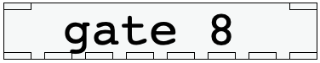
Gate Object
The gate object can have an arbitrary number of the outlets (between 1 – 8) as specified by an argument.
Depending the number received at the right inlet, it routes the incoming message to the associated outlet. If it receives 0 at the right inlet, it stops all the incoming message so that it doesn’t pass through.
For instance, if the integer value received at the right inlet was 3, it routes the incoming messages to the third outlet from the left. Similarly if the integer value was 8, it routes the incoming messages to the eighth outlet from the left.

Slide 105
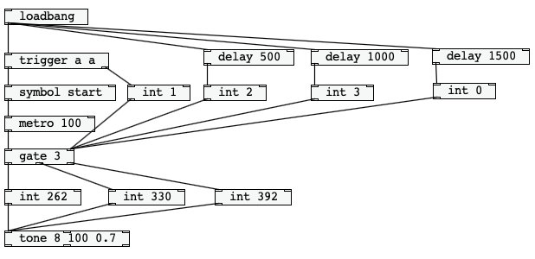
Ardestan: Example 07
The below program changes the output outlet of the gate object every 500 msec to play a simple melody.

Slide 106
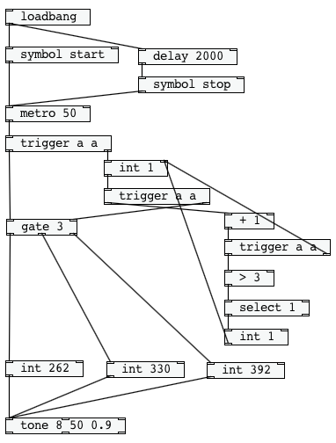
Ardestan: Example 08
Here is a little more advanced example for the gate object.
The example program plays C-D-E-C-D-E repeatedly (but very quickly!)

Slide 107

Arithmetic Operator
When it receives a value at the right inlet, it stores the value.
When it receives a value at the left inlet, it performs the arithmetic operation.
The default stored value can be given as an argument.
% is used for modulo.

Slide 108

Relational Operator
A relational operator object compares two values.
If it received a value at the right inlet, it just stores it inside.
If it received a value at the left inlet, it compares the input value and the stored value.
If the condition is true, it outputs 1. If not, it outputs 0.
The default stored value can be given as an argument.

Slide 109

Logical Operator
A logical operator objects handles two Boolean values (true or false = non-zero or zero in Ardestan).
A logical-and object (&&) output 1 if both are true, 0 if either of two values is false.
A logical-or object (||) outputs 1 if either of two values is true, and 0 if both are false.
When it received a value at the right inlet, it just stores the value.
When it received a value at the left inlet, it performs the operation between the input value and the stored value.
The default value can be given as an argument.

Slide 110

Select Object
The ‘select’ object sends out a ’bang’ message if the message received at the left inlet is the same as its value (in the above case ‘1’).
Otherwise, it sends the received message as it is from the right outlet.

Slide 111
How to Implement a Counter
This part of the program implements a counter, which counts 1, 2, 3, 1, 2, 3, 1, 2 3…

Slide 112
How to Implement a Counter
Let’s zoom this part and see what happens here.

Slide 113
How to Implement a Counter
First, note that the initial value stored here is 1.
1

Slide 114
How to Implement a Counter
When the int object received a ‘bang’, it outputs ‘1’ to the trigger object.
1

Slide 115
How to Implement a Counter
First, ‘1’ is sent to the gate object by the trigger object, resulting the output outlet of the gate object to the left most inlet.
1

Slide 116
How to Implement a Counter
Then, the trigger object ends ‘1’ to the ‘+’ object.
1

Slide 117
How to Implement a Counter
The ‘+’ object adds ‘1’ to the incoming integer value. The output will be ‘2’
2

Slide 118
How to Implement a Counter
The ‘+’ object adds ‘1’ to the incoming integer value. The output will be ‘2’
2

Slide 119
How to Implement a Counter
Now, the value stored in this int object will be ‘2’.
2

Slide 120
How to Implement a Counter
Now, the ‘>’object receives ‘2’. As 2 is not larger than 3, it outputs ‘0’ (which means false).
2

Slide 121
How to Implement a Counter
As 0 is not 1, the select object pass through 0 from its right inlet, but there is no connection from the right inlet, the message passing is finished.
0

Slide 122
How to Implement a Counter
To summarize, What just happened is (1) the gate objects opens its first inlet (as it received ‘1’) and (2) the above integer object now stores ‘2’. ‘2’ will be the next output from the int object.
2
open

Slide 123
How to Implement a Counter
If the above trigger object receives a bang message again, the gate object opens its middle outlet and the above int object stores ‘3’.
3 (updated after opening the gate object’s middle outlet)
open
2

Slide 124
How to Implement a Counter
Now let’s see what happens from the below case.
3
open

Slide 125
How to Implement a Counter
The middle trigger object receives ‘3’.
3
open

Slide 126
How to Implement a Counter
The gate objects receives ‘3’ and opens the right outlet.
open
3

Slide 127
How to Implement a Counter
The ’+’ object receives ‘3’ and outputs ‘4’.
open
3
4

Slide 128
How to Implement a Counter
The above int objects will be updated to ‘4’.
4
open

Slide 129
How to Implement a Counter
The ‘>’ receives ‘4’ and it is larger than ‘3’, so the output will be ‘1’ (which means true).
4
open
4
1

Slide 130
How to Implement a Counter
The incoming message (integer value ‘1’) is the same as what the select object stores, so it outputs a ‘bang’ message.
4
open
1
bang

Slide 131
How to Implement a Counter
The below int object sends out ‘1’ to the above int object, resetting the stored value to ‘1’; Hence, the next output will be one
1
open

Slide 132
How to Implement a Counter
This is how a counter algorithm is implemented in the below part, and why it repeats the output 1, 2, 3, 1, 2, 3, 1, 2, 3…

Slide 133
What We Learned So Far
Introduction to the Ardestan Visual Programming Language
object boxes and connections
inlets and outlets
arguments
messages
loadbang object
symbol object
dout object
depth-first message-passing
hot and cold inlets
Timing objects
delay object
metro object
Digital Output
Ohm’s law
resistor
breadboard
LED
vibration motor
mini piezo speaker
tone object
Flow Control
trigger object
gate object
select object
spigot object
Operators
arithmetic operator object
relational operator object
logical operator objects
Algorithm
counter implementation
Serial Monitor
serial object
serial_println object
Digital Input
din_change object
toggle object
pull-up resistor
chatter (contact bounce)

Slide 134
Session 1.4: Serial Monitor

Slide 135

Serial Monitor
There is a ‘Serial Monitor’ window inside the Ardestan IDE.

Slide 136
Serial Monitor
Your computer and Arduino are connected via Serial Port (USB-Serial). You can use this connection also to communicate with Arduino.
Image of Arduino: https://commons.wikimedia.org/wiki/File:Arduino_Uno_-_R3.jpg (Creative Commons Attribution 2.0 Generic license).

Slide 137
Serial Monitor
‘Serial’ means that it transfer one bit at once (which means the serial I/O doesn’t send two or more bits simultaneously).
Image of Arduino: https://commons.wikimedia.org/wiki/File:Arduino_Uno_-_R3.jpg (Creative Commons Attribution 2.0 Generic license).

Slide 138
Serial Monitor
To utilize the serial communication, we need to set the communication speed (bit per second) the same on the both sides.
Image of Arduino: https://commons.wikimedia.org/wiki/File:Arduino_Uno_-_R3.jpg (Creative Commons Attribution 2.0 Generic license).

Slide 139

Ardestan: Example 09
Write a simple program as below and set up the serial monitor to 9600 bps.

Slide 140

Serial Monitor
Write a simple program as below and set up the serial monitor to 9600 bps.
This sets up the Arduino’s serial communication speed to 9600 bps.
This sets up the computer’s serial communication speed to 9600 bps.
The serial_println object convert the received value to a string and send it to your computer via the serial port.

Slide 141

Serial Monitor
Upload your program to the Arduino and then activate your Serial Monitor.

Slide 142

Serial Monitor
The Serial Monitor window should see the receive message as below

Slide 143

Serial Monitor
The serial_println object can be helpful for debugging.
See the help file for more details.

Slide 144
What We Learned So Far
Introduction to the Ardestan Visual Programming Language
object boxes and connections
inlets and outlets
arguments
messages
loadbang object
symbol object
dout object
depth-first message-passing
hot and cold inlets
Timing objects
delay object
metro object
Digital Output
Ohm’s law
resistor
breadboard
LED
vibration motor
mini piezo speaker
tone object
Flow Control
trigger object
gate object
select object
spigot object
Operators
arithmetic operator object
relational operator object
logical operator objects
Algorithm
counter implementation
Serial Monitor
serial object
serial_println object
Digital Input
din_change object
toggle object
pull-up resistor
chatter (contact bounce)

Slide 145
Session 1.5: Digital Input

Slide 146

Digital Input
Create a simple circuit as below

Slide 147

Ardestan: Example 10
The ‘din_change’ object
outputs ‘0’ when the switch is pushed.
outputs ‘1’ when the switch is released.
The dout object interprets ‘1’ as ‘high’ and ‘0’ as low.
What happens when you run this program on your Arduino?

Slide 148

Toggle Object
The ‘toggle’ object sends out ‘1’ and ‘0’ alternately every time when it received a ‘bang’ message.

Slide 149

Exercise 05
Modify the example 06 with a ‘select’ object and a ‘toggle’ object.
Turn on the LED when the button is pushed. The LED must be kept turned on even after the button is released.
Turn off the LED when the button is pushed again. LED must be kept turned off even after the button is released.
In short, change the LED status: on -> off, off -> on, every when the button is pushed.
20 min. After you finished this example, explain what is happening in the code to the lecturer.

Slide 150

Ardestan: Example 11
This is one of the possible answers.
Now, modify this example to use two buttons and two LEDs.

Slide 151
Pull-up resistor
Create a simple circuit as below
1 = high, 0 = low.
Why does the output become ‘0,’ when the button is pushed?

Slide 152

Pull-up resistor
Think of such a circuit.
If the button is pushed, the digital input will be high.
If the button is released, what the input will be?

Slide 153
Pull-up resistor
Think of such a circuit.
If the button is pushed, the digital input will be high.
If the button is released, what the output will be?
The digital input will be unstable, since the circuit is open.

Slide 154


Pull-up resistor
Use a pull-up resistor!

Slide 155

Pull-up resistor
When the switch is open (the button is not pushed),the input is connected to the 5v (=high).
We need a resistor to avoid a short circuit (we can’t ‘+’ and ‘–’ directly as it breaks your Arduino).
This is why we need a resistor.

Slide 156

Pull-up resistor
When the switch is closed (the button is pushed),the electricity flows into the GND directly.
Almost no electricity to the digital input.
Why? The electricity prefers the route with less resistance.
The Arduino itself is also seen as a resistor.
But the route to ground has no resistance.

Slide 157
Pull-up resistor
So when the button is pushed, the input will be ‘0’ !

Slide 158
Pull-up resistor
So when the button is pushed, the input will be ‘0’ !

Slide 159
Pull-up resistor
Then, why is there no resistor in this case?

Slide 160

Pull-up resistor
Indeed, the Arduino has a built-in pull-up resistor.
Ardestan normally uses it.

Slide 161

Chatter (Contact Bounce)
However, the input can be still unstable, when the button is pushed/released.
Why?

Slide 162

Chatter (Contact Bounce)
When the switch is pushed/released, the voltage may go up and down rapidly before settling.
The switch contacts are normally made of springy metals and causes such bounces when the contacts strike together.
The image is cited from https://upload.wikimedia.org/wikipedia/commons/a/ac/Bouncy_Switch.png (license: public domain)

Slide 163

Spigot Object
Spigot object
If the input at the right inlet is ‘1,’ it let any message received at the left inlet passes through.
If it receives the ‘0,’ at the right inlet, it stops any message received at the left inlet and nothing will be output.
Image https://www.needpix.com/photo/176452/water-faucet-pipes-tap-spigot-old-metal (public domain)

Slide 164

Ardestan: Example 12
Explain what happens in this program.
What would happen if the user pushed the button at the digital input #8 and then again after 1 second.

Slide 165
Neglecting Contact Bounces
When the input message to the spigot object arrives, it first pass it through, since the initial state of the spigot is ‘open’ (note that the argument is set to ‘1’, which means ‘open’).
The toggle object receives the ‘bang’ message and sends ‘1’ out to the metro object, which starts blinking the LED at the pin #9.
bang

Slide 166
Neglecting Contact Bounces
The bang message is also sent to the trigger object and the right int object will receive it.
You might have noticed that the trigger object is converting the bang message to another bang message by giving the argument ‘b’. This seems meaningless in this program, Yet this is better because we can input any type of messages to this algorithm and it could be helpful because we may use other type of messages when we modularize this algorithm as a subpatch (we will learn about this in the next session).
bang
bang

Slide 167
Neglecting Contact Bounces
When the right int object outputs the message ‘1’ to the right inlet of the spigot object, the spigot object immediately closes its outlet and starts neglecting all the incoming messages.
0
closed!

Slide 168
Neglecting Contact Bounces
Then, the trigger object also outputs a bang message to the delay object.
The depth-first message-passing process is finished here, as the delay object keeps the bang message within for the next 200 msec.
Note that the spigot object is now closed.
Hence, even when contact bounces occur and many ‘bang’ messages are sent to the spigot object, it simply neglects them and do nothing; the program doesn’t react to the contact bounces.
bang
closed!

Slide 169
Neglecting Contact Bounces
After 200 msec has passed, the delay object sends out the delayed ‘bang’ message to the left int object.
The left int object sends out ‘1’ to the right inlet of the spigot object. The spigot object will re-open the outlet.
Since we assume 200 msec is long enough for contact bounces to finish, this algorithm helps neglecting contact bounces in your program.
bang
1
re-open!

Slide 170
Exercise 06
Create both a program and circuit that
starts blinking LED when the button is pushed.
stops blinking LED when the button is pressed.
Use the spigot object to avoid contact bounces.

Slide 171
What We Learned Today
Introduction to the Ardestan Visual Programming Language
object boxes and connections
inlets and outlets
arguments
messages
loadbang object
symbol object
dout object
depth-first message-passing
hot and cold inlets
Timing objects
delay object
metro object
Digital Output
Ohm’s law
resistor
breadboard
LED
vibration motor
mini piezo speaker
tone object
Flow Control
trigger object
gate object
select object
spigot object
Operators
arithmetic operator object
relational operator object
logical operator objects
Algorithm
counter implementation
Serial Monitor
serial object
serial_println object
Digital Input
din_change object
toggle object
pull-up resistor
chatter (contact bounce)

Slide 172
Writing Assignment #1
Deadline: August 7th 23:59.

Slide 173
Midterm Project Proposal #1 (part of your midterm grade)
Write a brief note what is the design concept of your busy board.
(In other words, explain what and why).
What do you focus on in your design? colors, tactile texture, sound, materials?
What do you use? Why you use them?
The purchase list must be included (the purchase must be completed).
Don’t forget to organize your writing with sections (and subsections if necessary).
Max 300 words (expect the purchase list).
Deadline: August 10th 23:59.

Slide 174
Midterm Project Proposal #1 (part of your midterm grade)
You can go to DAISO or名創優品 to cheap materials.
Yet, it is highly recommended to search for materials that fit your concept as possible.
Don’t randomly create one without any concept!!

